Slide 1
SQL PROJECT
Ecommerce Database ANALYSIS

Slide 2
Objective of Project
To analyze Ecommerce database
To explore the Trending Services of Ecommerce Website
To study the trends of the different products, category and brands
To analyze the sales trend in different year
To achieve meaningful insights

Slide 3
BB Home, bb Royal and Fresho are the Top selling Brand according to Quantity

Slide 4
Whey protein powder, Olive oil and U-Clip Capper are the
Top Selling product by revenue
Oats Biscuits , Vandi and chocolate bar
Arethe Very less Selling Products by revenue

Slide 5
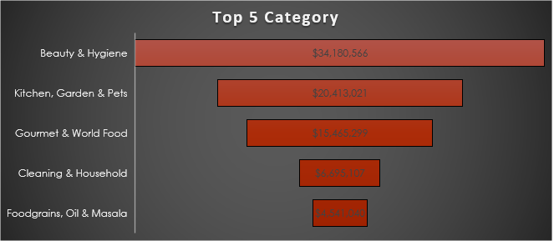
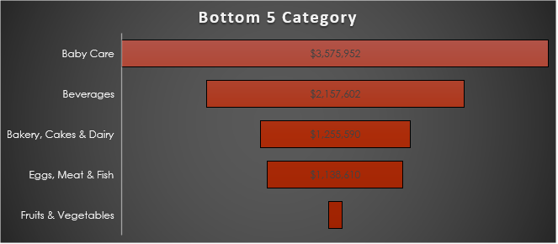
Beauty & Hygiene , kitchen and world food are the top selling category by revenue
Fruits & Vegetables , Eggs meat & fish and Bakery are the Very selling category by revenue

Slide 6
Skin care , Fragrances and Cookware are the Top selling Subcategory by Revenue
Organic , Herds and marinade are the very Less selling Subcategory by Revenue

Slide 7
AsiPartners , GreenDroship and Tasha Apporarel are highest revenue generated Company

Slide 8
According the sales Trend Line company show very Good growth is every Year

Slide 9
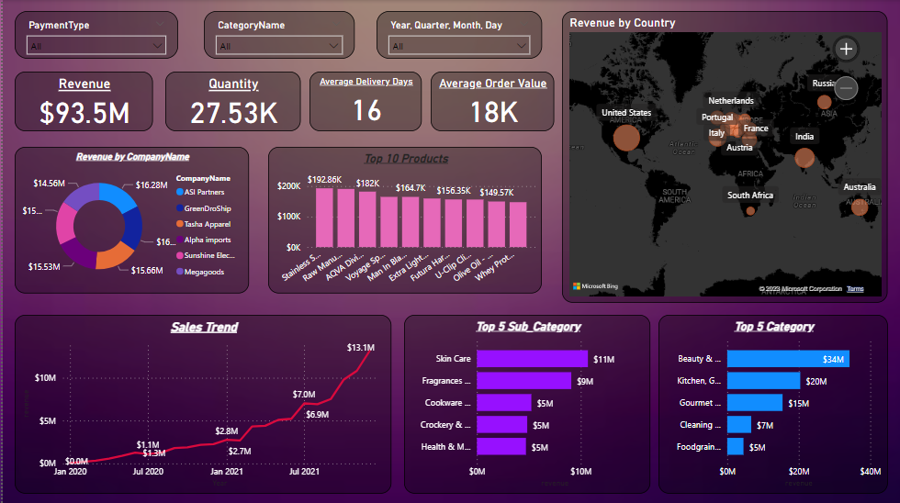

Slide 10
Conclusion
Sale growth is very good in every year
retention rate of customer is also good
Company need the decrease Delivery Time

